Slide 1
Glove for Deaf
By:
Abdallah Mahmoud Saad
Youssef Tamer Tobala

Slide 2
Usage Of Project:
Sign language is the primary way used to communicate to deaf people.
Uses different medium like hands, face, or eyes rather than vocals.
Sign language uses hand gestures and movements instead of spoken words.
Glove will be used to translate sign language for people unfamiliar with the language.

Slide 3
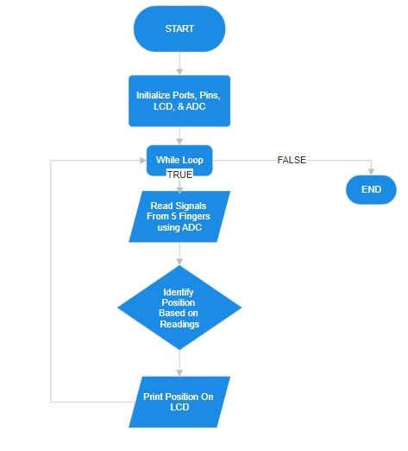
Methodology: Flowchart

Slide 4
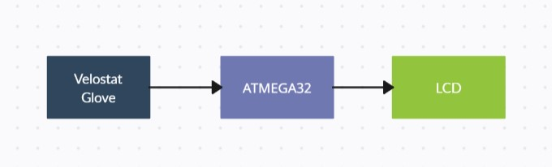
Methodology: Block Diagram

Slide 5
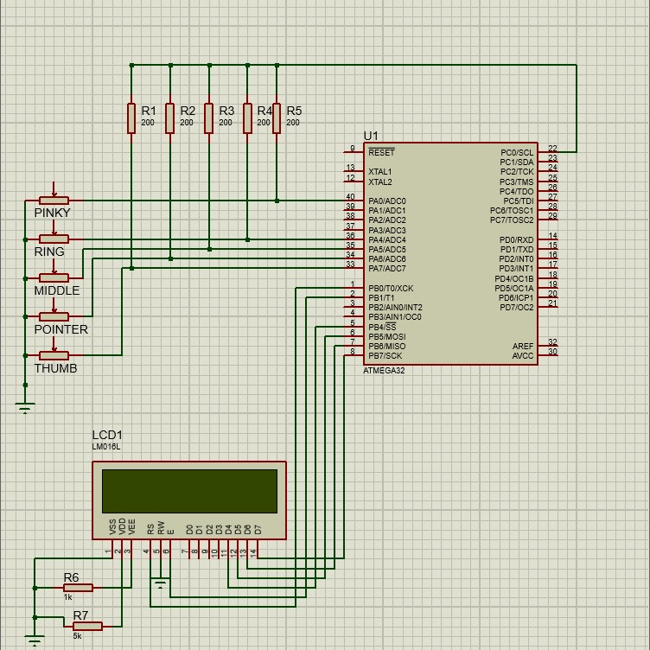
Methodology: Connection

